Slide 1
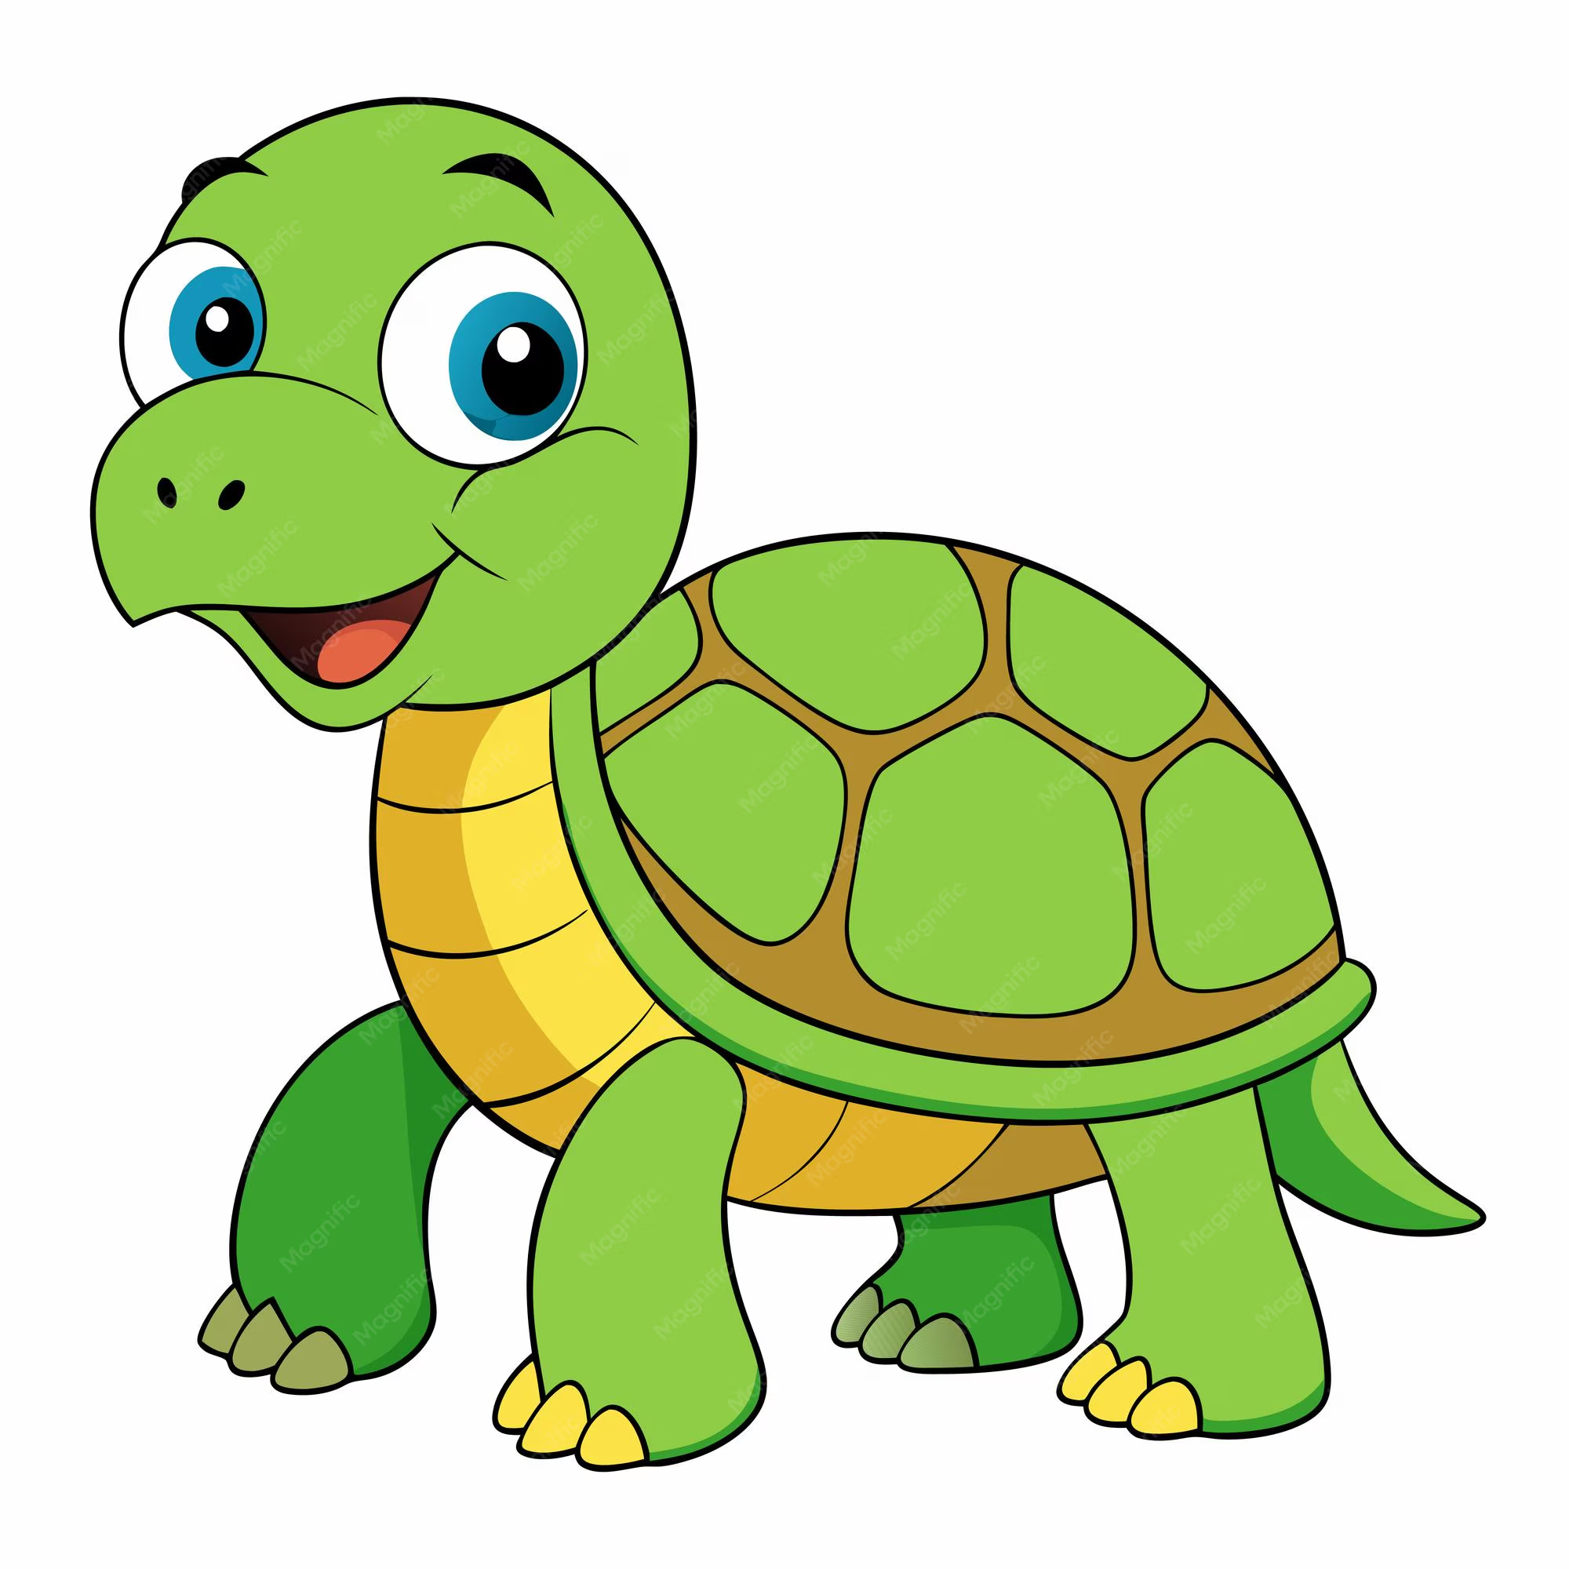
Welcome to Year 4!

Slide 2


Staff | Communication
Miss Ainsworth – Teacher Mrs Fish – TA Miss Hatch- TA Mrs Fallaize- PPA Cover Mrs Saddler- Team Theme - PE | Class Dojo School news letter Parents Meetings End of a school Day Mrs Fish will be on duty during breakfast club.

Slide 3
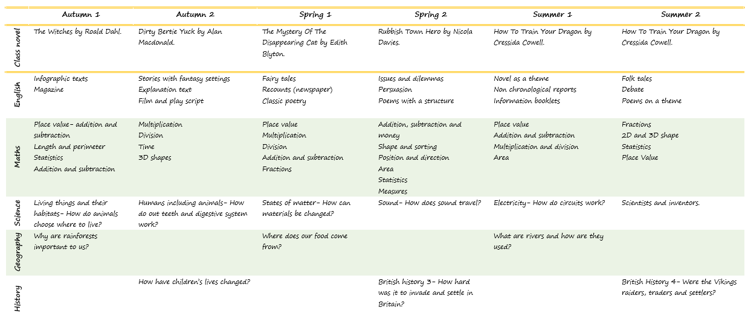
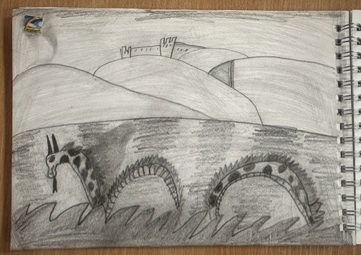
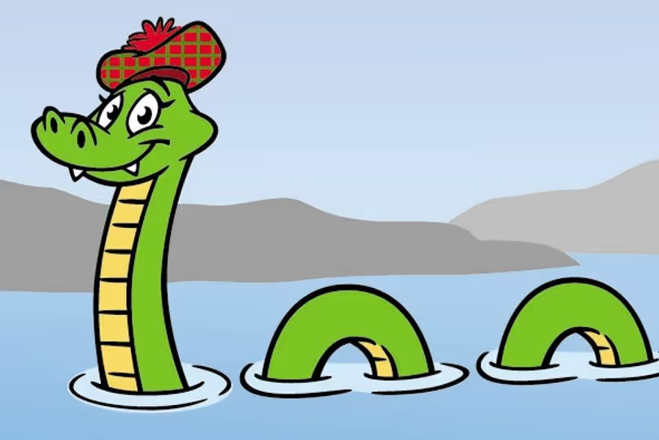
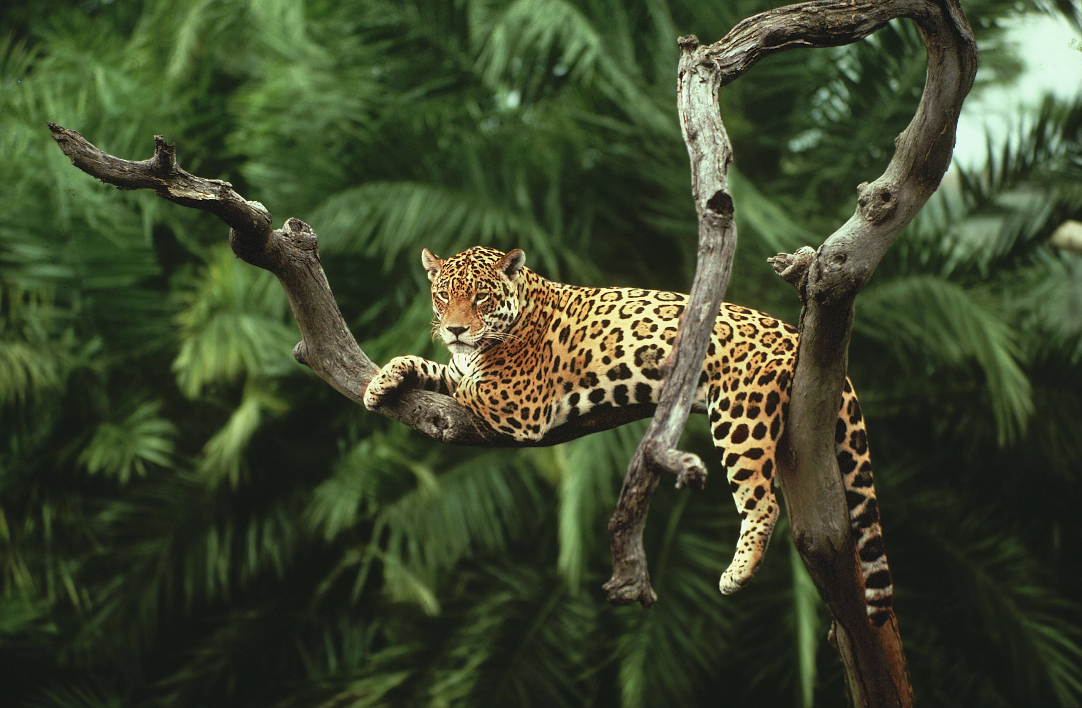

Curriculum
class page
Daily: Maths, English, Guided Reading and Handwriting.
Full Curriculum map is on the website.
Loch Live Camera
Living things and their habitats
Loch Ness
Story telling through drawings
Amazon Rainforest

Slide 4

Daily Routine
Arrive for 8:50, 3:20
Absences- contact the office, or dojo.
Children should be aware of their home time routine. If they are walking home alone, walking to KS1 or being collected.

Slide 5
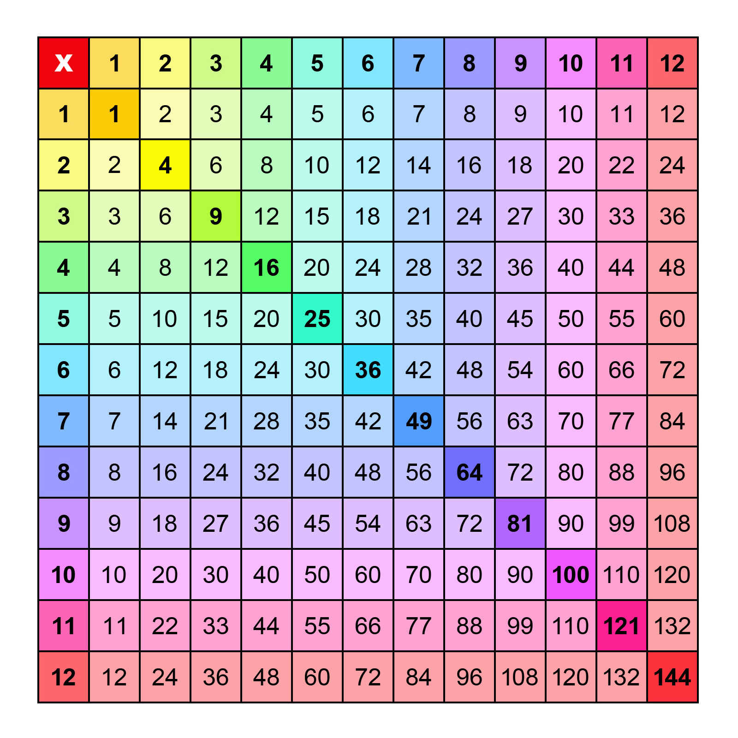
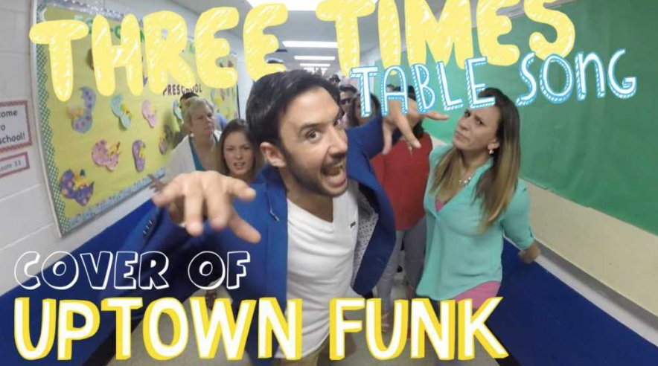
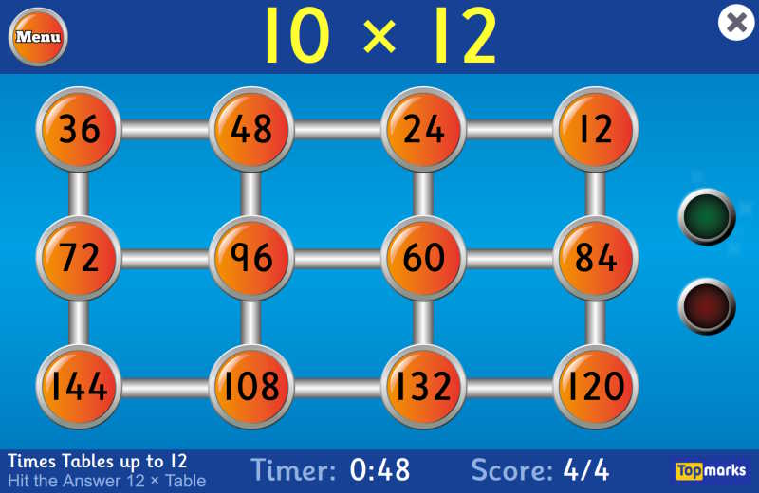
Times Tables
Multiplication Check 7 June to 18 June 2027.
Online test, 6 second timer.
demo

Slide 6
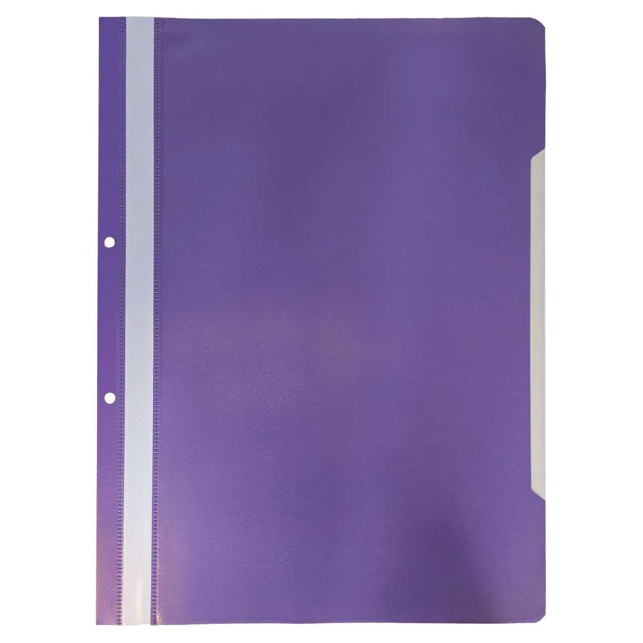
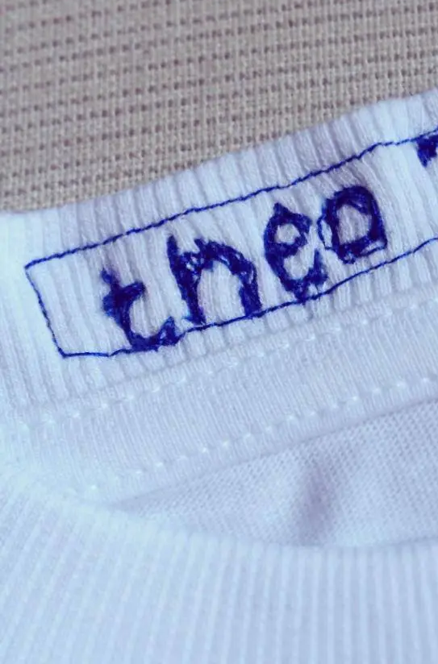
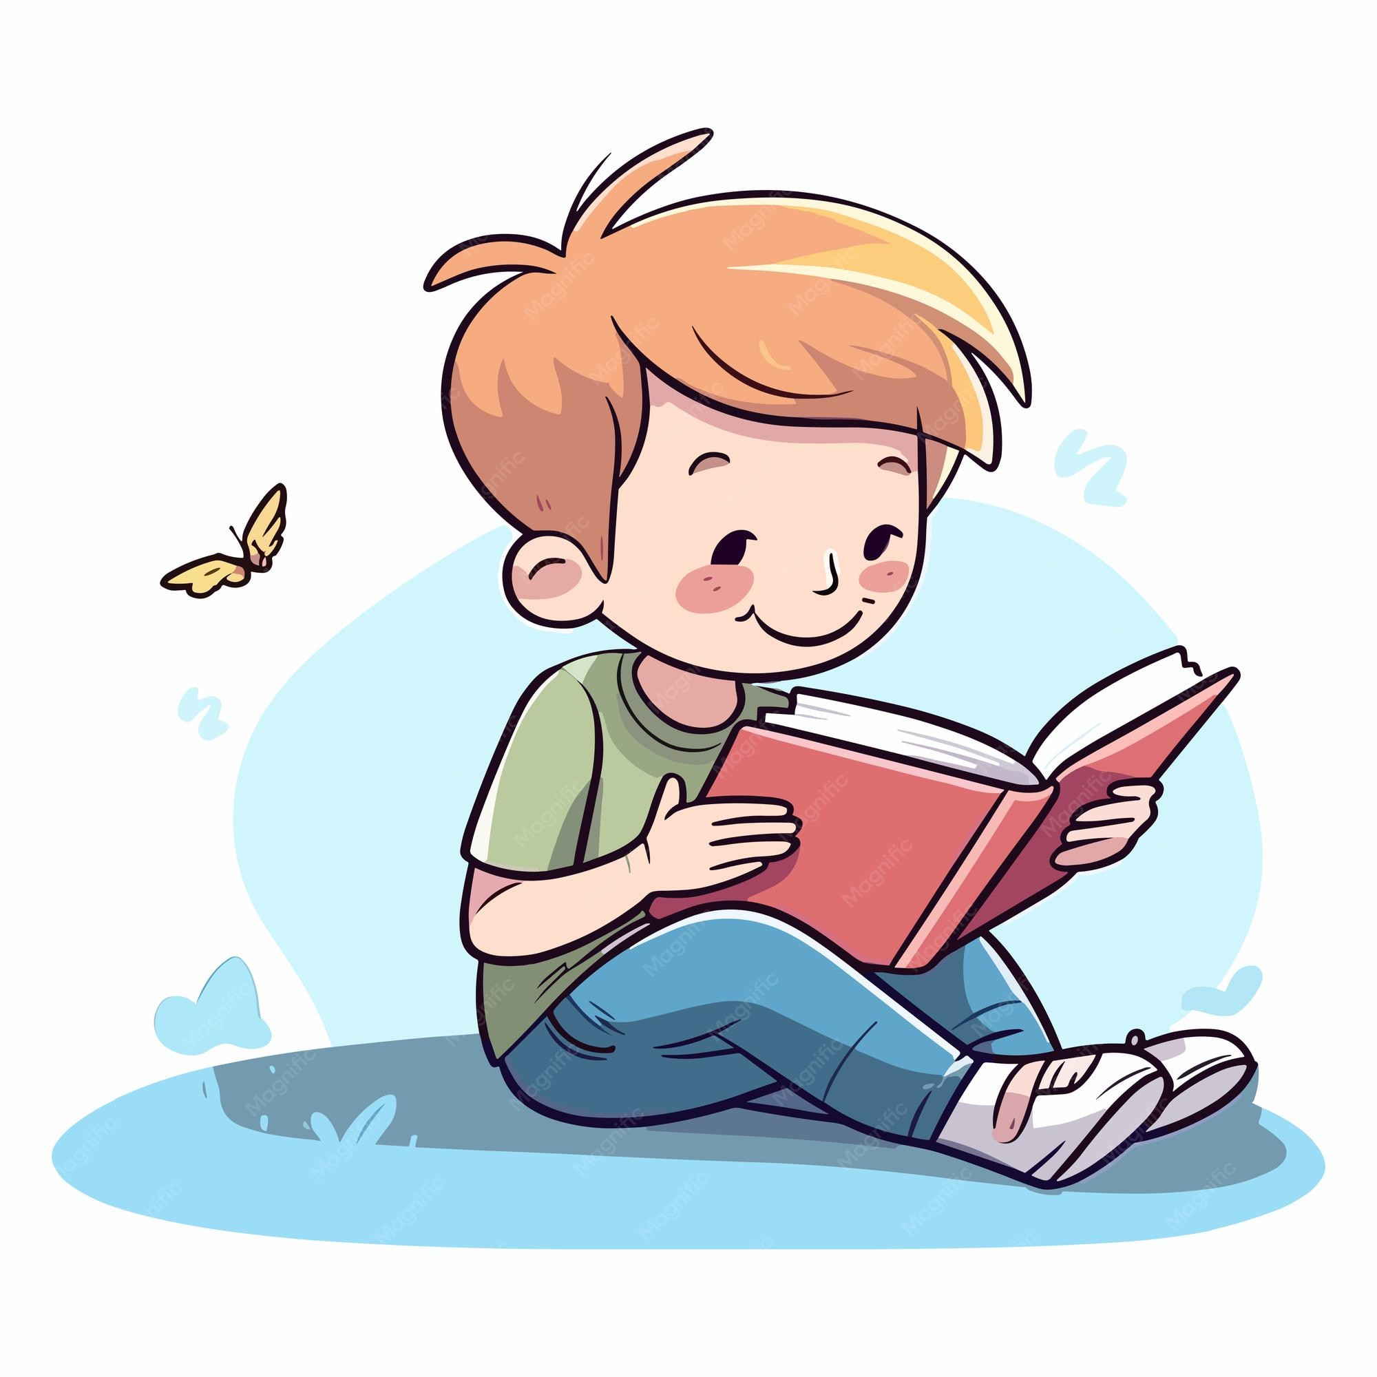

Homework | Reading | PE | Uniform
Spellings and timetables. Set on a Friday and due the following Friday. Spellings will be based on what we are learning in class. | Please sign the reading diary. We want to foster a love of reading for pleasure. Sitting with you sharing a book will have a huge impact. | Thursday – Team Theme Friday – Miss Ainsworth Kit: White t-shirt, black shorts, black trainers or pumps. Please no jewellery (safety). | Please make sure all unform is labelled. This way, if your child looses anything a staff member can return it to them.

Slide 7
Behaviour
Safe, Respect and Learning - 3 strands of behaviour
Regulation station, regulation plans, brain breaks.
Rewards and consequences that are clear and consistent.
Recognition Board
Message/phone call home
Prize Box
House Points
Visit to Mrs Cornwell
Certificates
Stickers
Lunch time awards
Tiny Tim visit!
Showing work to subject leaders
Verbal warnings
Message/phone call Home
Refusal of work completed at start of break or lunch if appropriate.
Visit to Mrs Cornwell

Slide 8
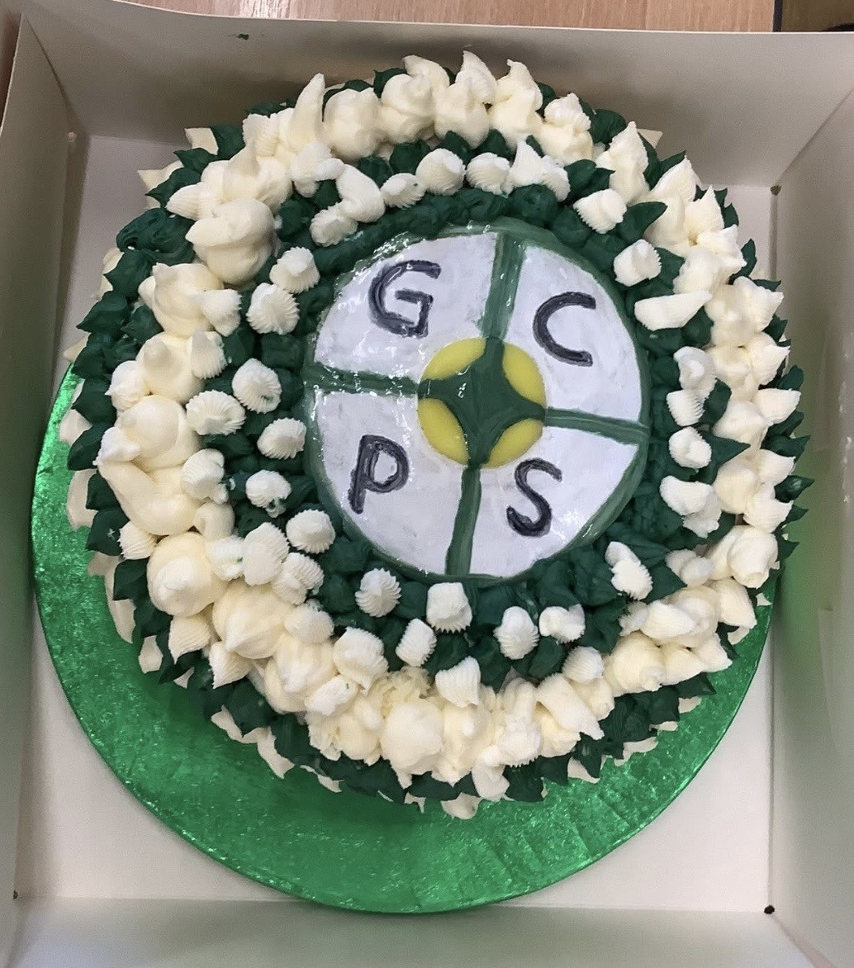
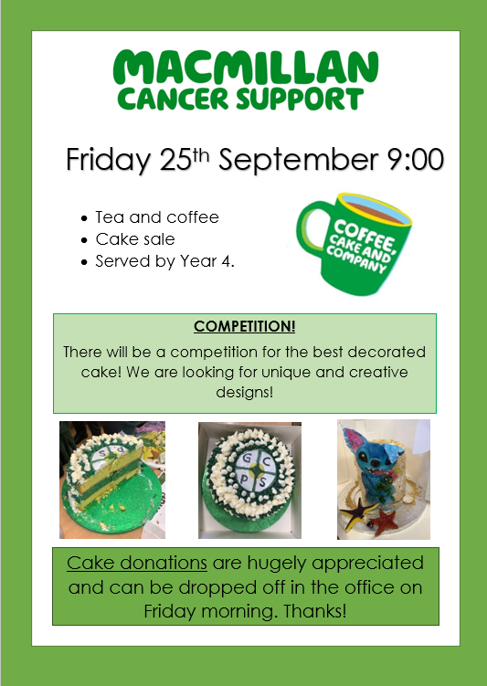
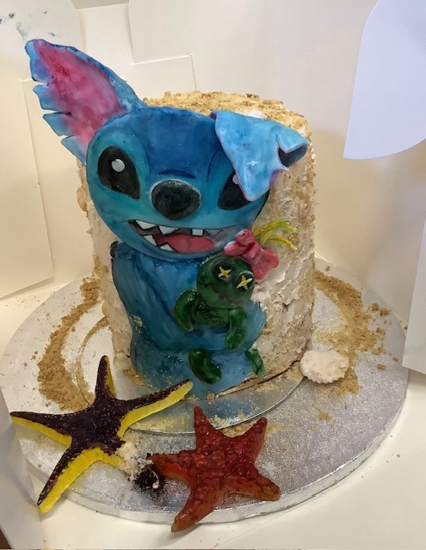

Slide 9
Supporting your child in Y4
Arrive on time.
Label uniform.
Support with homework- Including reading.
Ensure PE kits are in school.
Check class Dojo.
Practise their times tables and reassure!
If you would like to discuss anything 1-1 in private please feel free to stay behind at the end.

