Slide 1
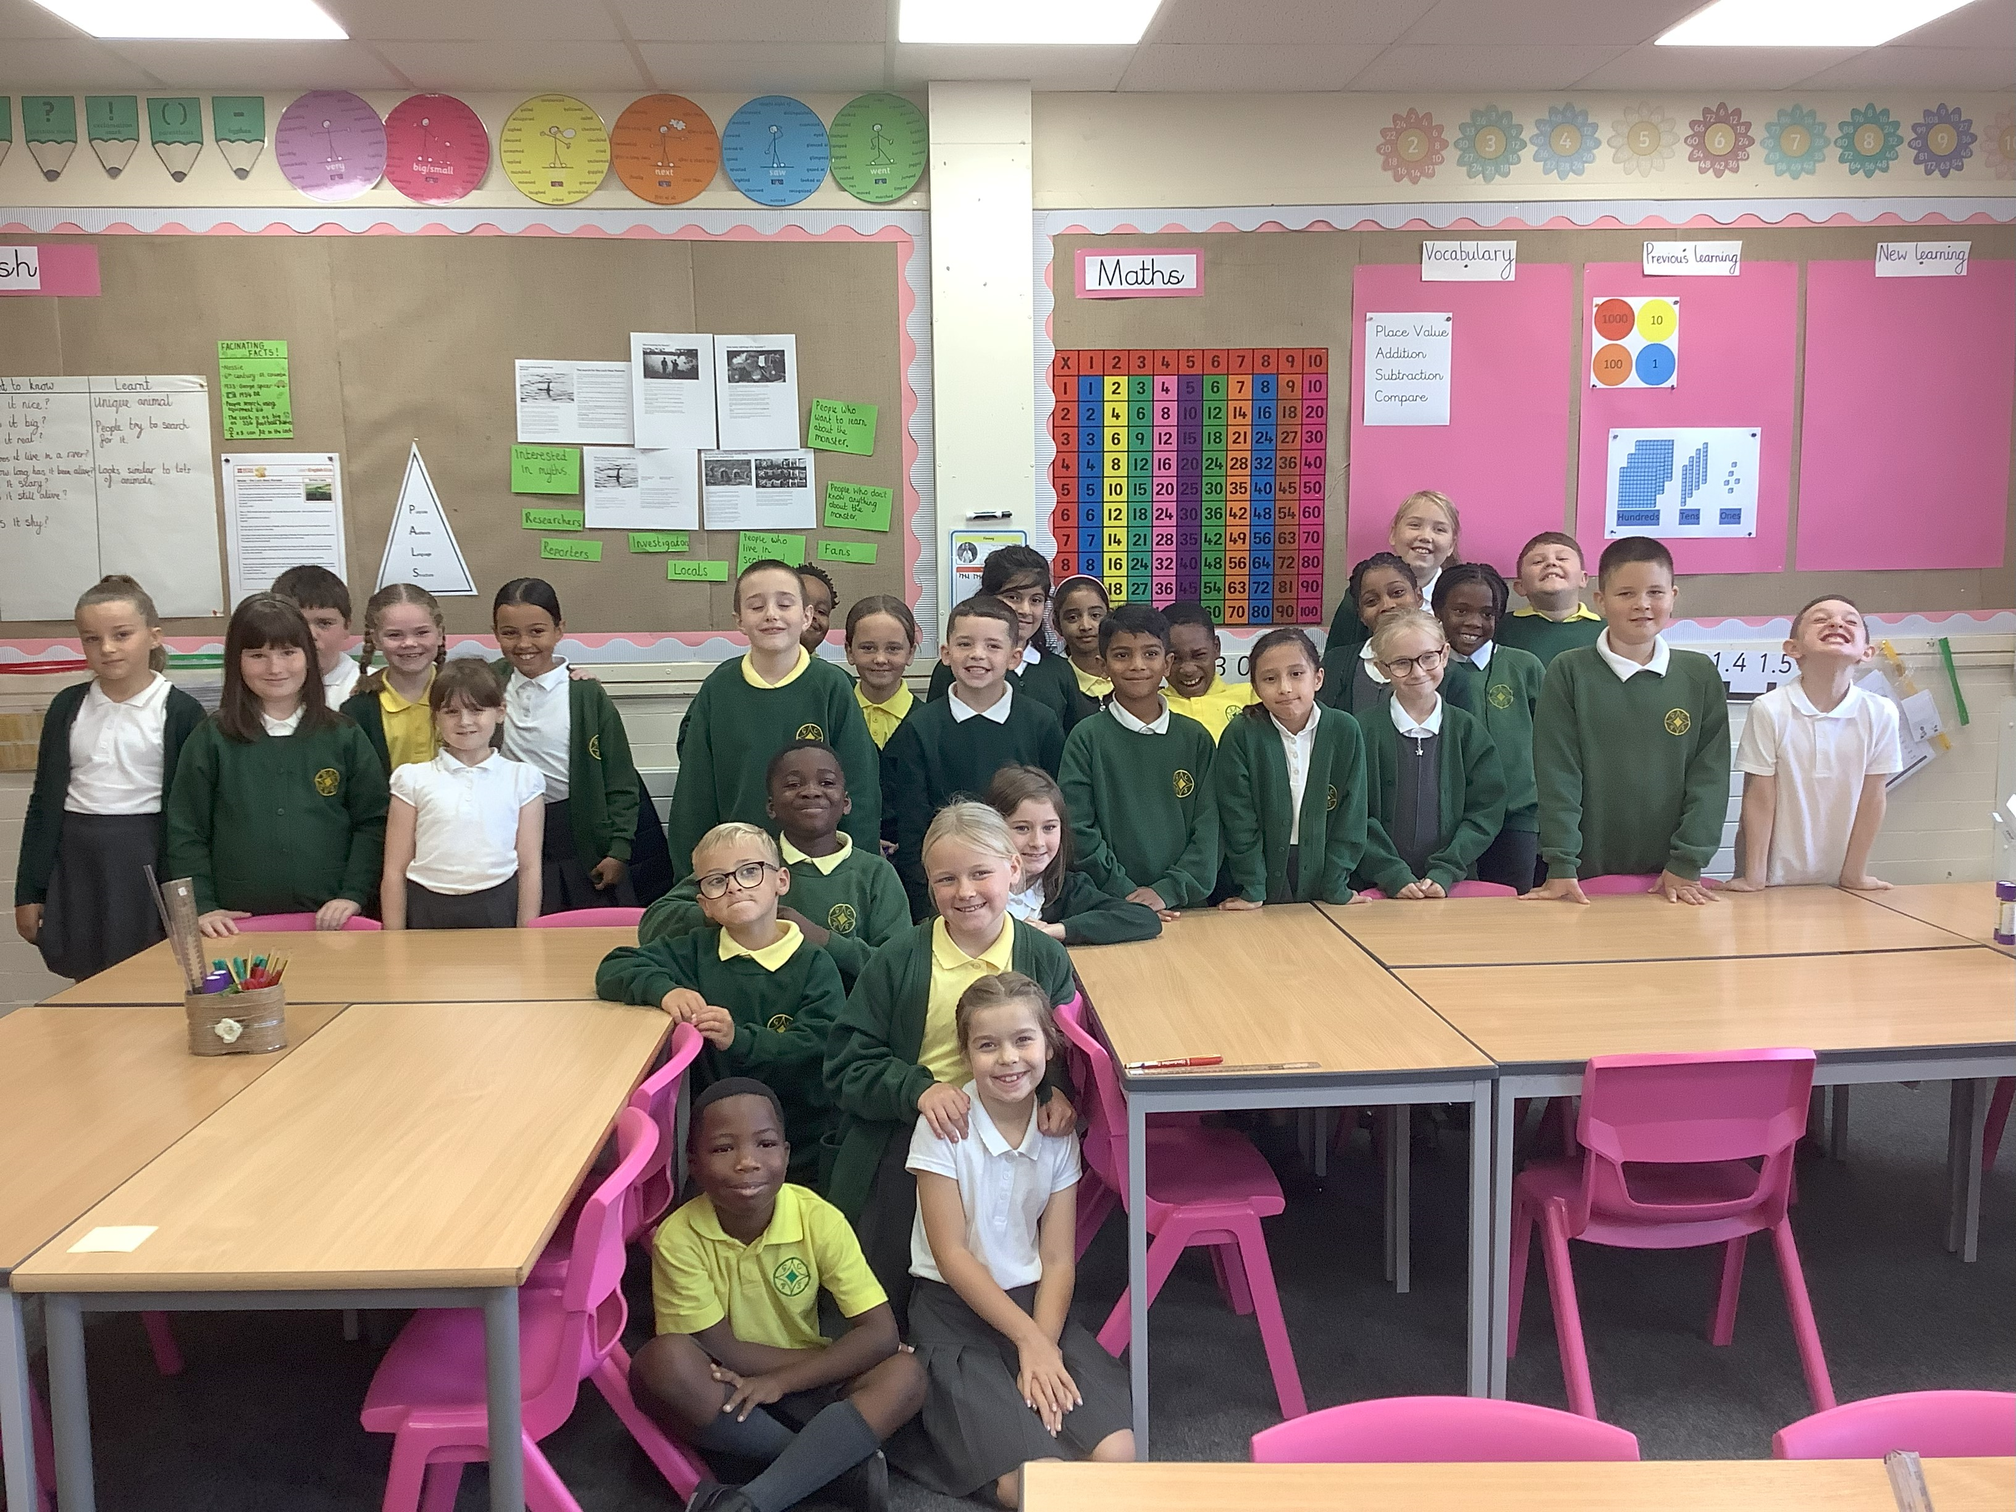
Welcome to Year 4!

Slide 2
Meet the Staff
Miss Ainsworth – Class teacher
Mrs Fish – TA and welfare staff
Mr Kelly- Thursday morning
Team Theme - PE

Slide 3
Behaviour
Safe, Respect and Learning - 3 strands of behaviour
Regulation station, regulation plans and nurture sessions for those who need extra help
Rewards and Sanctions that are clear and consistent
Developing intrinsic motivation within the child

Slide 4
Rewards and Consequences
Recognition Board
Dojo points
Message home
Prize Box
House Points
Golden Time
Visit to Mrs Cornwell
Certificates
Stickers
Message Home
Loose Dojo points
Incomplete work completed at start of break or lunch if appropriate.

Slide 5

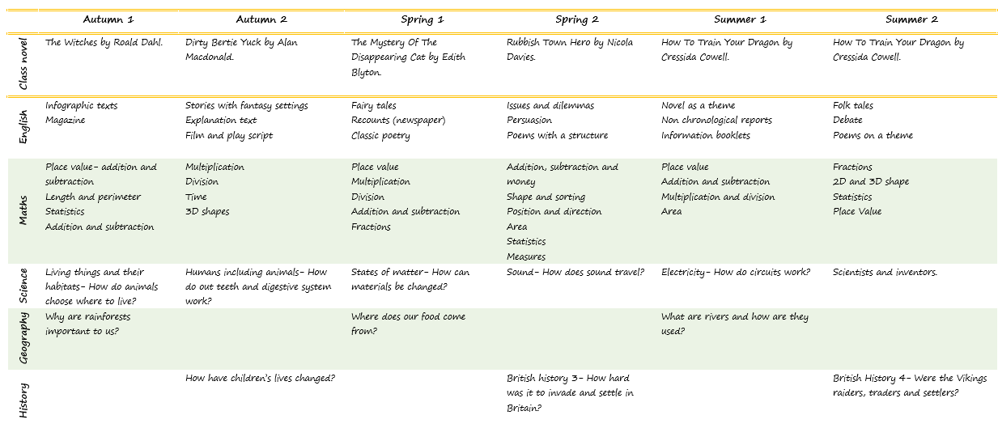

Curriculum
Maths, English, Guided Reading and Handwriting daily.
Science, PSHE, RE, Music, PE, French, Computing.
History/Geography Art/DT

Slide 6


Communication
Class Dojo
School news letter
Parents Meetings
End of a school Day

Slide 7
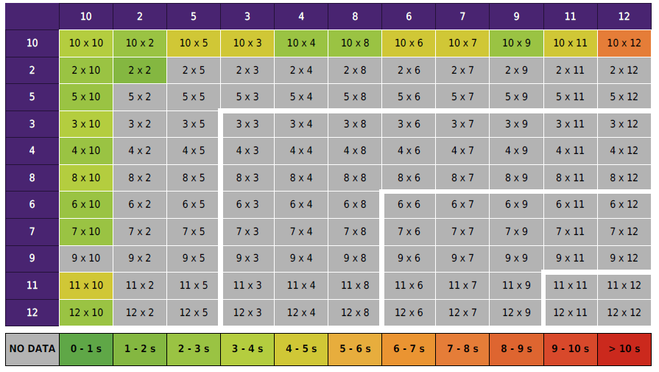
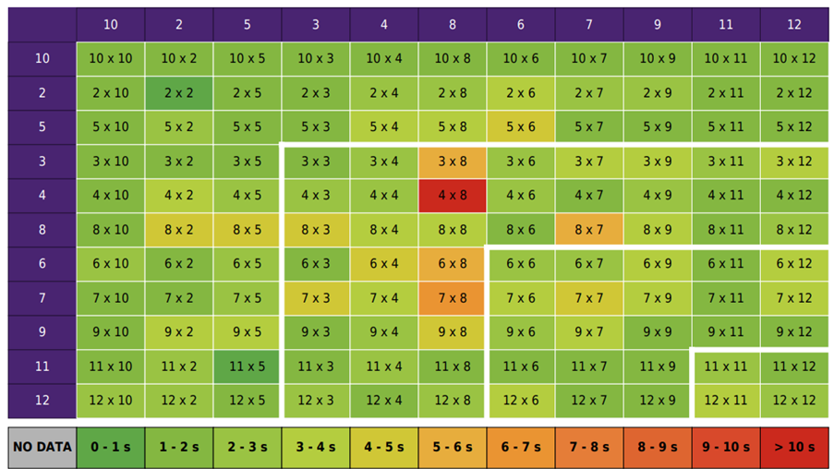
Times Tables
1
2
5
10
11
9
3
4
6
7
8
12
Times Table Check in June
6 Seconds
Times Table Rock stars
Songs
Games

Slide 8

PE
Thursday – Team Theme
Friday – Miss Ainsworth
Kit: White t-shirt, black shorts, black trainers or pumps.
Please no jewellery.

Slide 9
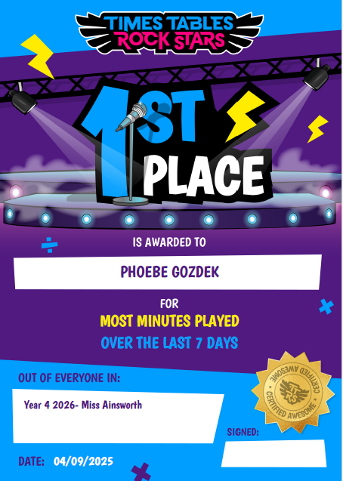
Homework
Homework task- Times Table Rock stars
Class Spellings- Edshed
Set on a Friday and due the following Friday.
Certificates for 1st 2nd 3rd.

Slide 10

Reading
At least 3 times a week as part of their homework.
Please sign the diary.
We want to foster a love of reading for pleasure. Sitting with you sharing a book will have a huge impact.

Slide 11

Daily Routine
Arrive for 8:50
Doors close at 9:00
Absences- contact the office, or dojo.
3:20 Pick up- Please let me know if someone else is picking your child up.

Slide 12





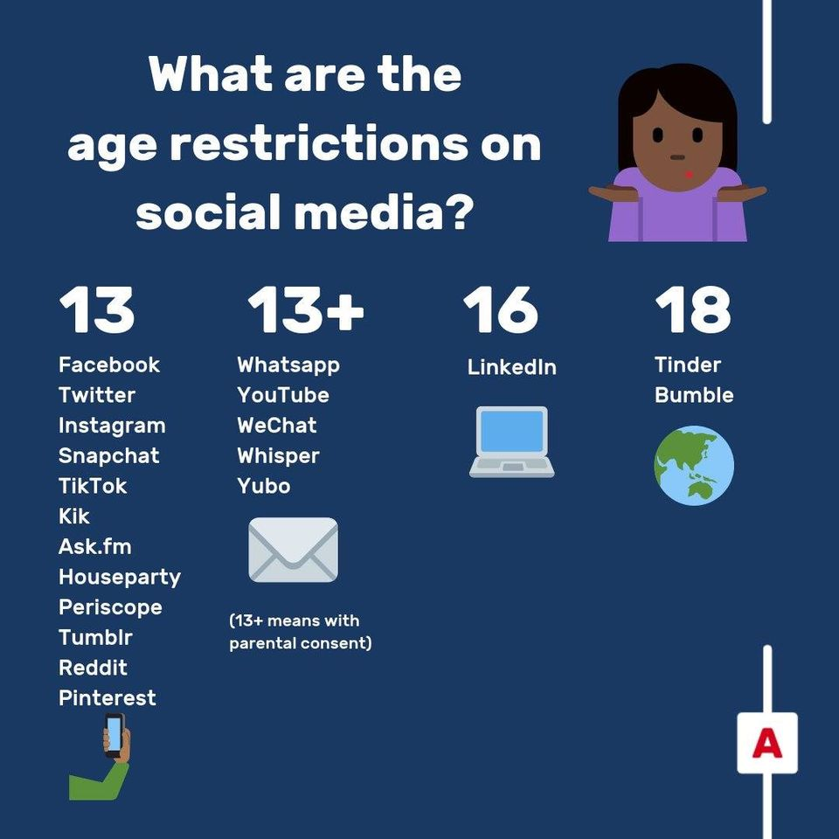
Social Media
Please consider carefully before allowing your child to go on social media. At under 12 years old, they are well below the age limit. They are very often not emotionally mature enough to use it safely, and it can cause huge fall outs and arguments in school. They are also exposed to adult language and content which can have a detrimental effect on their mental health.
Parents and Carers - UK Safer Internet Centre

Slide 13
Supporting your child in Y4
Arrive on time.
Label uniform.
Support with homework- Including reading.
Ensure PE kits are in school.
Check Dojo.
Practise their times tables and reassure!
Help them tell the time and use real money in wider life.

